Slide 1
Hill Climbing

Slide 2
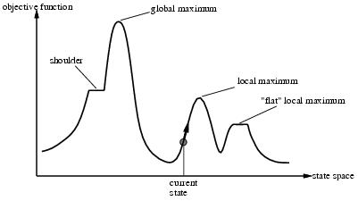
“Landscape” of search for max value

Slide 3
Hill Climbing - Algorithm
1. Pick a random point in the search space
2. Consider all the neighbours of the current state
3. Choose the neighbour with the best quality and move to that state
4. Repeat 2 thru 4 until all the neighbouring states are of lower quality
5. Return the current state as the solution state

Slide 4
Hill Climbing - Algorithm
Function HILL-CLIMBING(Problem) returns a solution state
Inputs:Problem, problem
Local variables:Current, a node
Next, a node
Current = MAKE-NODE(INITIAL-STATE[Problem])
Loop do
Next = a highest-valued successor of Current
If VALUE[Next] < VALUE[Current] then return Current
Current = Next
End

Slide 5
Hill-climbing search
“a loop that continuously moves in the direction of increasing value”
terminates when a peak is reached
Aka greedy local search
Value can be either
Objective function value
Heuristic function value (minimized)
Hill climbing does not look ahead of the immediate neighbors of the current state.
Can randomly choose among the set of best successors, if multiple have the best value
Characterized as “trying to find the top of Mount Everest while in a thick fog”

Slide 6
Hill Climbing

Slide 7
Hill-climbing example
8-queens problem, complete-state formulation
All 8 queens on the board in some configuration
Successor function:
move a single queen to another square in the same column.
Example of a heuristic function h(n):
the number of pairs of queens that are attacking each other (directly or indirectly)
(so we want to minimize this)

Slide 8
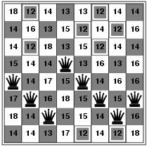
Hill-climbing example
(c₁ c₂ c₃ c₄ c₅ c₆ c₇ c₈) = (5 6 7 4 5 6 7 6)
Current state: h=17
Shown is the h-value for each possible successor in each column

Slide 9
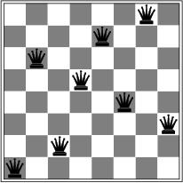
A local minimum for 8-queens
A local minimum in the 8-queens state space (h=1)

Slide 10
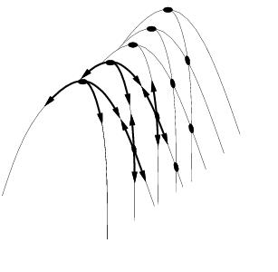
Other drawbacks
Ridge = sequence of local maxima difficult for greedy algorithms to navigate
Plateau = an area of the state space where the evaluation function is flat.

Slide 11
Performance of hill-climbing on 8-queens
Randomly generated 8-queens starting states…
14% the time it solves the problem
86% of the time it get stuck at a local minimum
However…
Takes only 4 steps on average when it succeeds
And 3 on average when it gets stuck
(for a state space with ~17 million states)

Slide 12
Possible solution…sideways moves
If no downhill (uphill) moves, allow sideways moves in hope that algorithm can escape
Need to place a limit on the possible number of sideways moves to avoid infinite loops
For 8-queens
Now allow sideways moves with a limit of 100
Raises percentage of problem instances solved from 14 to 94%
However….
21 steps for every successful solution
64 for each failure

Slide 13
Hill-climbing variations
Stochastic hill-climbing
Random selection among the uphill moves.
The selection probability can vary with the steepness of the uphill move.
First-choice hill-climbing
stochastic hill climbing by generating successors randomly until a better one is found
Useful when there are a very large number of successors
Random-restart hill-climbing
Tries to avoid getting stuck in local maxima.

Slide 14
Hill-climbing with random restarts
Different variations
For each restart: run until termination v. run for a fixed time
Run a fixed number of restarts or run indefinitely
Analysis
Say each search has probability p of success
E.g., for 8-queens, p = 0.14 with no sideways moves
Expected number of restarts?
Expected number of steps taken?

Slide 15
Local beam search
Keep track of k states instead of one
Initially: k randomly selected states
Next: determine all successors of k states
If any of successors is goal → finished
Else select k best from successors and repeat.
Major difference with random-restart search
Information is shared among k search threads.
Can suffer from lack of diversity.
Stochastic beam search
choose k successors proportional to state quality.

Slide 16
Search using Simulated Annealing
Simulated Annealing = hill-climbing with non-deterministic search Basic ideas:
like hill-climbing identify the quality of the local improvements
instead of picking the best move, pick one randomly
say the change in objective function is δ
if δ is positive, then move to that state
otherwise:
move to this state with probability proportional to δ
thus: worse moves (very large negative δ) are executed less often
however, there is always a chance of escaping from local maxima
over time, make it less likely to accept locally bad moves
(Can also make the size of the move random as well, i.e., allow “large” steps in state space)

Slide 17
Physical Interpretation of Simulated Annealing
Annealing = physical process of cooling a liquid or metal until particles achieve a certain frozen crystal state
simulated annealing:
free variables are like particles
seek “low energy” (high quality) configuration
get this by slowly reducing temperature T, which particles move around randomly

Slide 18
Simulated annealing
function SIMULATED-ANNEALING( problem, schedule) return a solution state
input: problem, a problem
schedule, a mapping from time to temperature
local variables: current, a node.
next, a node.
T, a “temperature” controlling the probability of downward steps
current ← MAKE-NODE(INITIAL-STATE[problem])
for t ← 1 to ∞ do
T ← schedule[t]
if T = 0 then return current
next ← a randomly selected successor of current
∆E ← VALUE[next] - VALUE[current]
if ∆E > 0 then current ← next
else current ← next only with probability e^{∆E /T}

